Slide 1
2021 학년도 기계공학과 CADD (MEE1002) CADD(Computer Aided Design and Drafting) H.W. #9
학번 :
이름 :
2021년 11월 11일

Slide 2
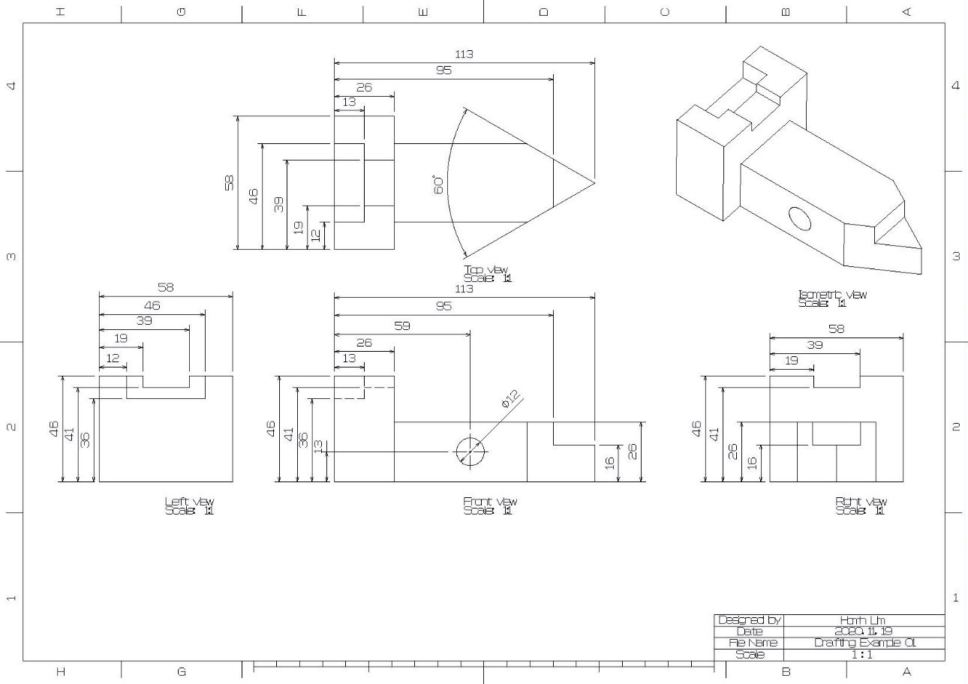
1
CADD(Computer Aided Design and Drafting) H.W. #9
H.W. #9

Slide 3
1
CADD(Computer Aided Design and Drafting) H.W. #9
H.W. #9

Slide 4
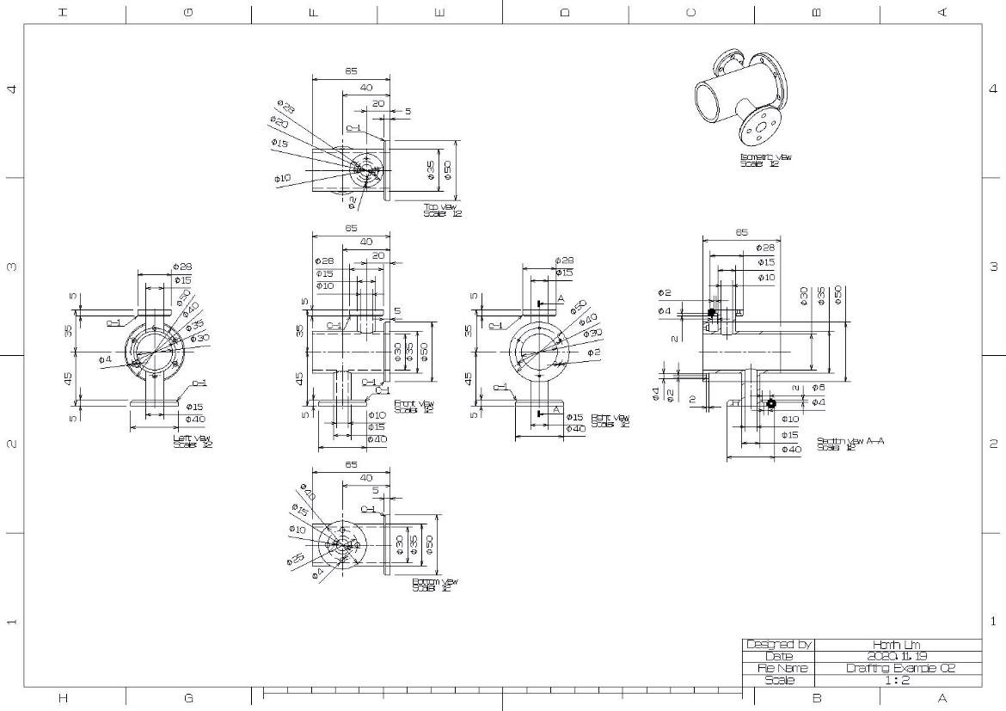
1
CADD(Computer Aided Design and Drafting) H.W. #9
H.W. #9

Slide 5
1
CADD(Computer Aided Design and Drafting) H.W. #9
H.W. #9

Slide 6
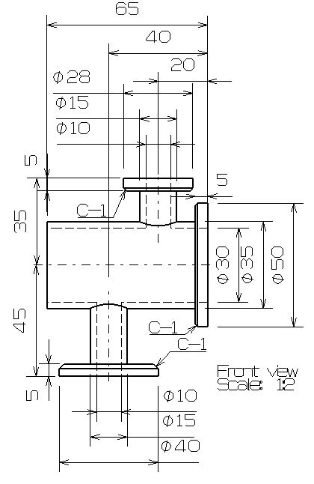
1
CADD(Computer Aided Design and Drafting) H.W. #9
H.W. #9

Slide 7
1
CADD(Computer Aided Design and Drafting) H.W. #9
H.W. #9

Slide 8
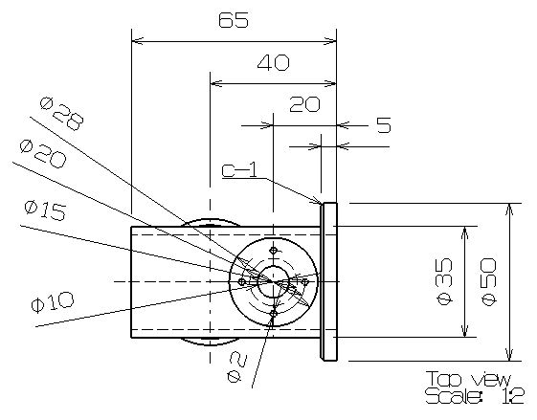
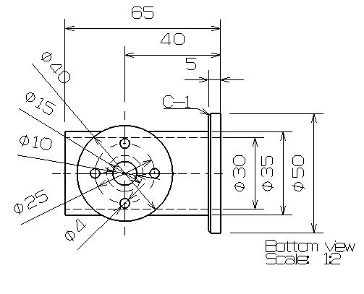
1
CADD(Computer Aided Design and Drafting) H.W. #9
H.W. #9

Slide 9
1
CADD(Computer Aided Design and Drafting) H.W. #9
H.W. #9

Slide 10
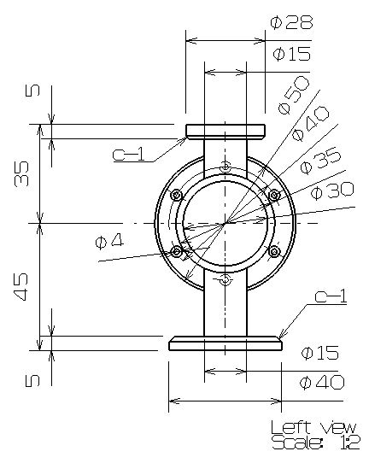
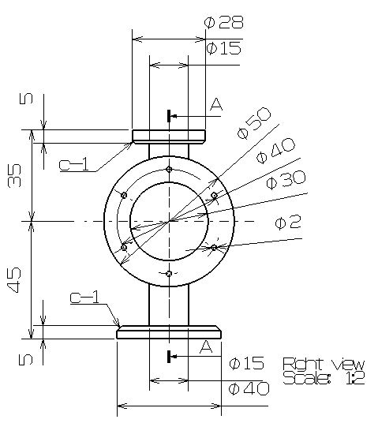
1
CADD(Computer Aided Design and Drafting) H.W. #9
H.W. #9

Slide 11
1
CADD(Computer Aided Design and Drafting) H.W. #9
H.W. #9

Slide 12
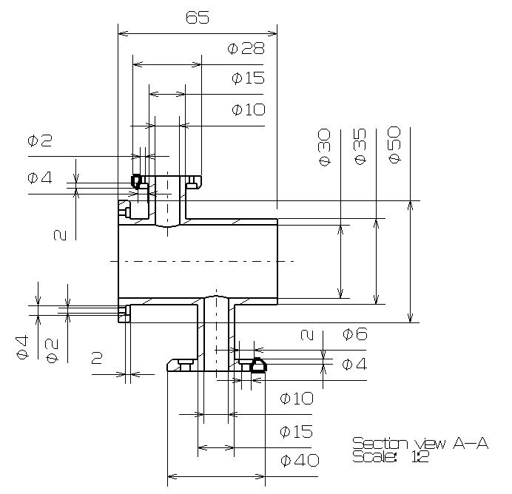
1
CADD(Computer Aided Design and Drafting) H.W. #9
H.W. #9

Slide 13
1
CADD(Computer Aided Design and Drafting) H.W. #9
H.W. #9

