Slide 1
2021 학년도 기계공학과 CADD (MEE1002) CADD(Computer Aided Design and Drafting) H.W. #8
학번 :
이름 :
2021년 10월 21일

Slide 2
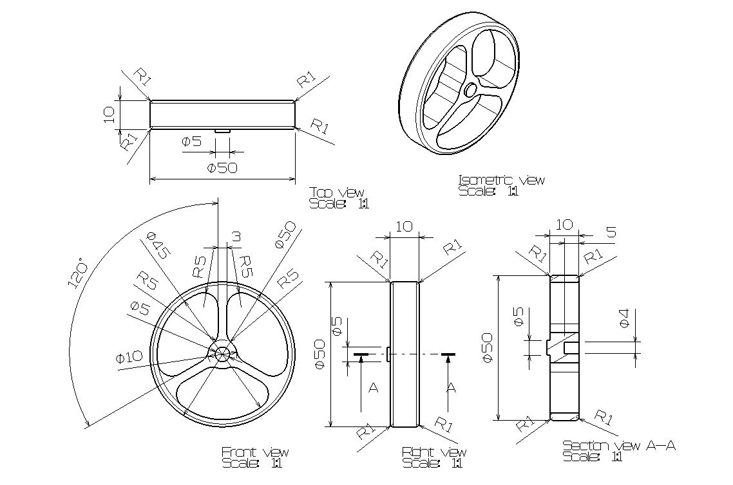
1
CADD(Computer Aided Design and Drafting) H.W. #8
H.W. #8

Slide 3
1
CADD(Computer Aided Design and Drafting) H.W. #8
H.W. #8

Slide 4
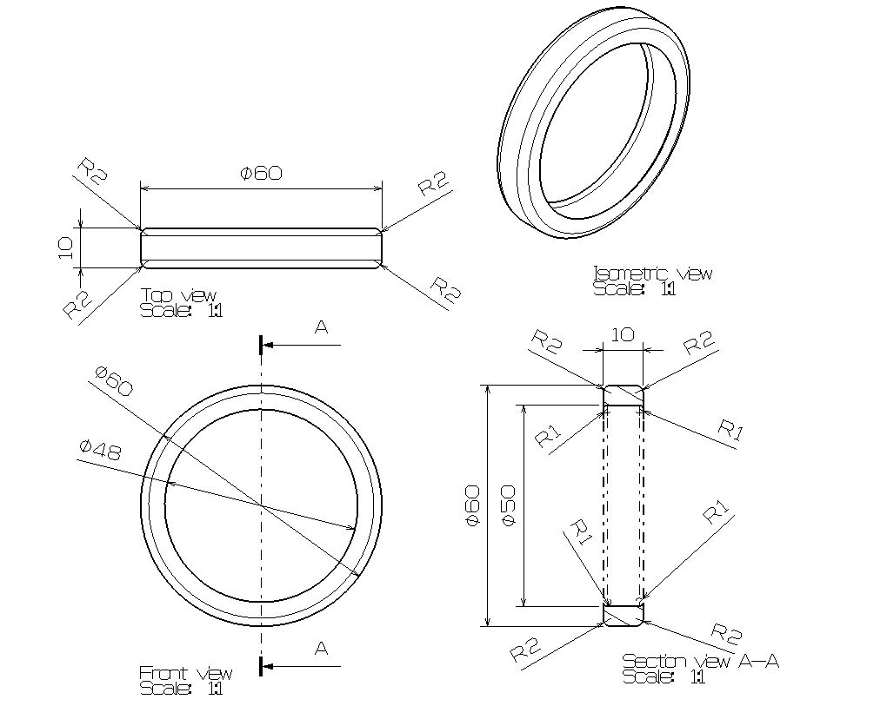
1
CADD(Computer Aided Design and Drafting) H.W. #8
H.W. #8

Slide 5
1
CADD(Computer Aided Design and Drafting) H.W. #8
H.W. #8

Slide 6
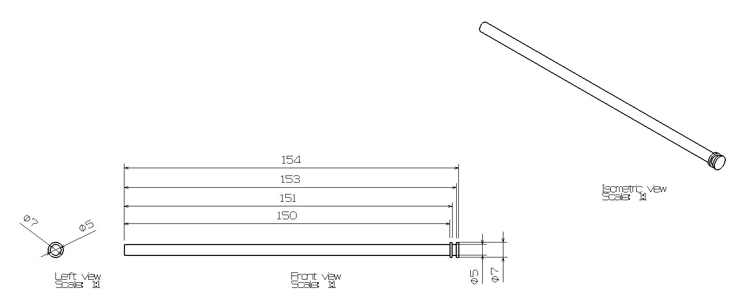
1
CADD(Computer Aided Design and Drafting) H.W. #8
H.W. #8

Slide 7
1
CADD(Computer Aided Design and Drafting) H.W. #8
H.W. #8

Slide 8
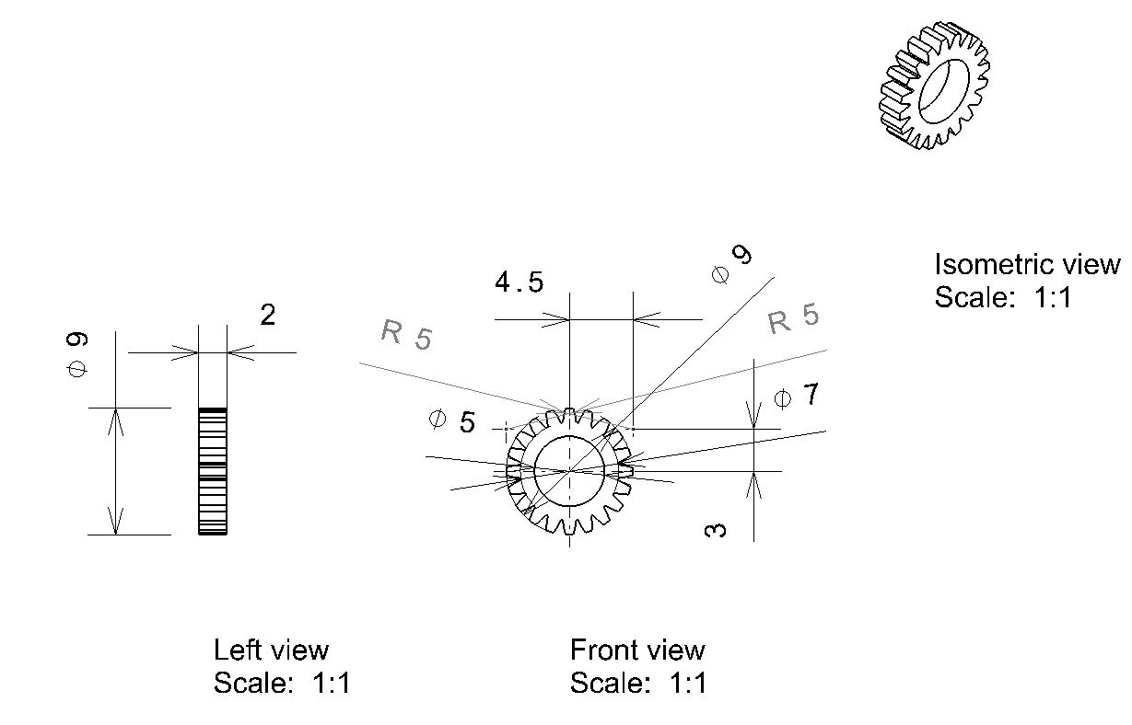
1
CADD(Computer Aided Design and Drafting) H.W. #8
H.W. #8

Slide 9
1
CADD(Computer Aided Design and Drafting) H.W. #8
H.W. #8

Slide 10
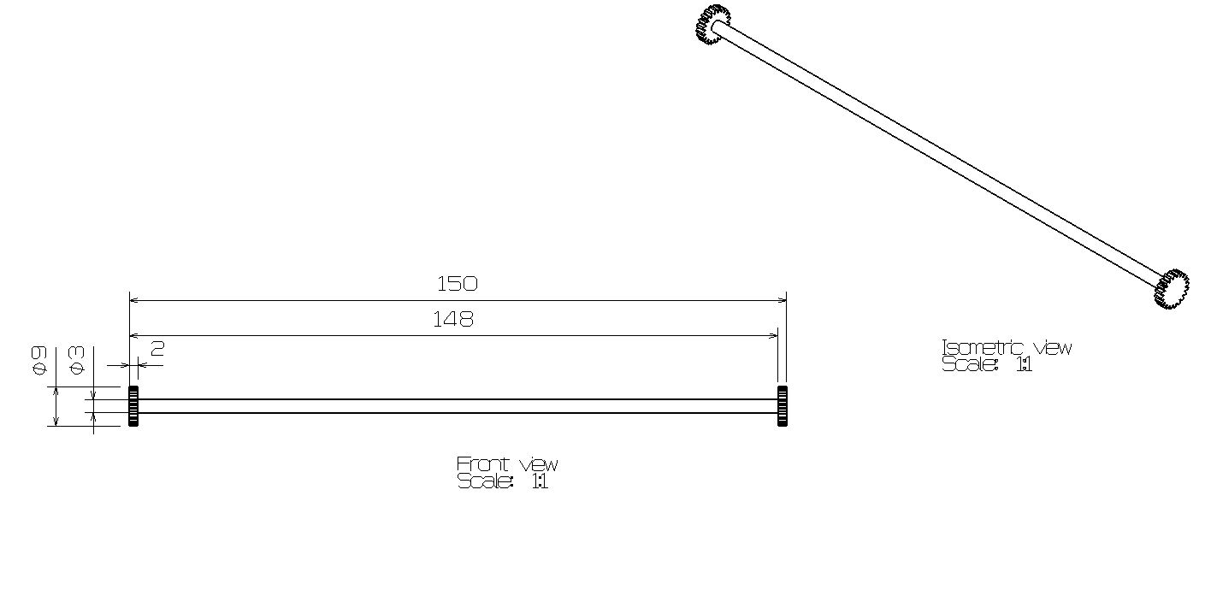
1
CADD(Computer Aided Design and Drafting) H.W. #8
H.W. #8

Slide 11
1
CADD(Computer Aided Design and Drafting) H.W. #8
H.W. #8

Slide 12
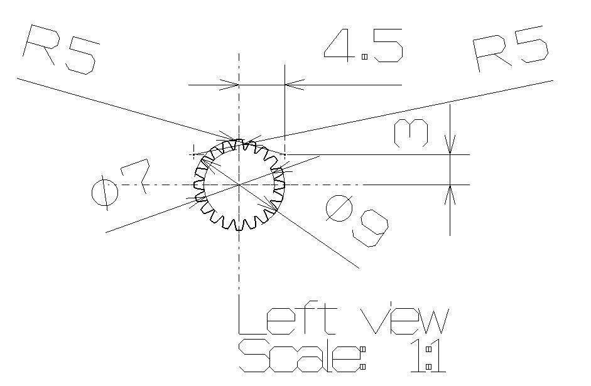
1
CADD(Computer Aided Design and Drafting) H.W. #8
H.W. #8

Slide 13
1
CADD(Computer Aided Design and Drafting) H.W. #8
H.W. #8

Slide 14
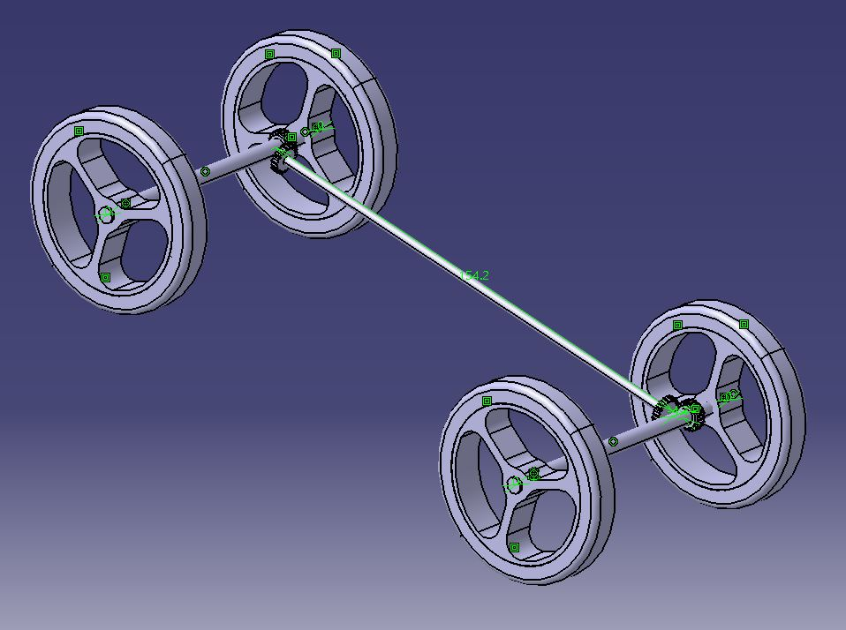
1
CADD(Computer Aided Design and Drafting) H.W. #8
H.W. #8

Slide 15
1
CADD(Computer Aided Design and Drafting) H.W. #8
H.W. #8

