Slide 1
2021 학년도 기계공학과 CADD (MEE1002) CADD(Computer Aided Design and Drafting) H.W. #6
학번 :
이름 :
2021년 10월 25일

Slide 2
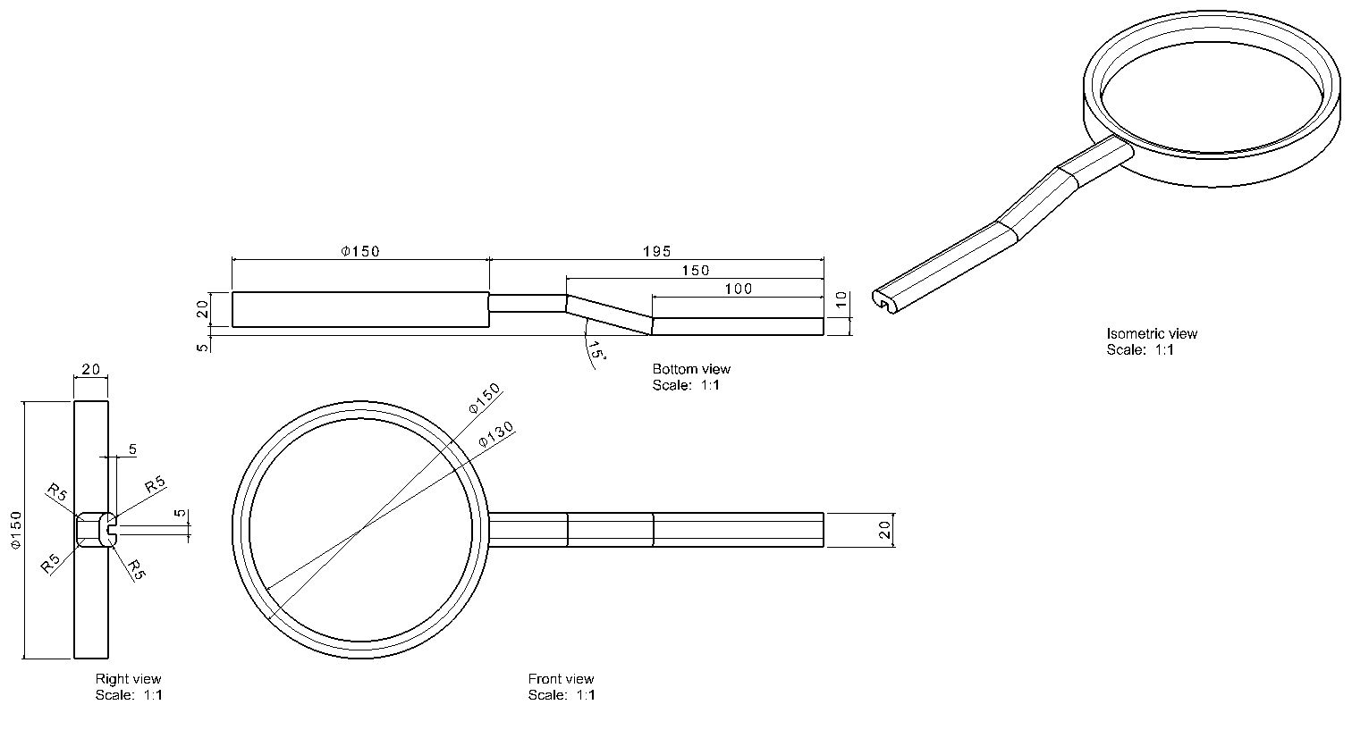
1
CADD(Computer Aided Design and Drafting) H.W. #6
H.W. #6

Slide 3
1
CADD(Computer Aided Design and Drafting) H.W. #6
H.W. #6

Slide 4
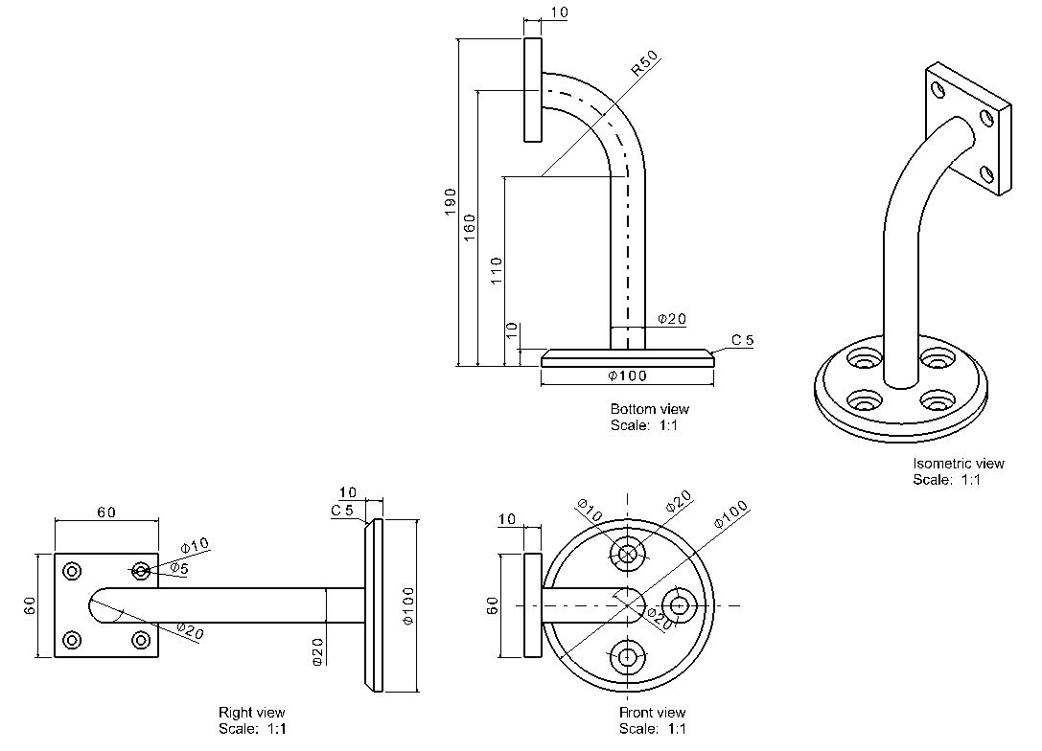
2
CADD(Computer Aided Design and Drafting) H.W. #6
H.W. #6

Slide 5
2
CADD(Computer Aided Design and Drafting) H.W. #6
H.W. #6

Slide 6
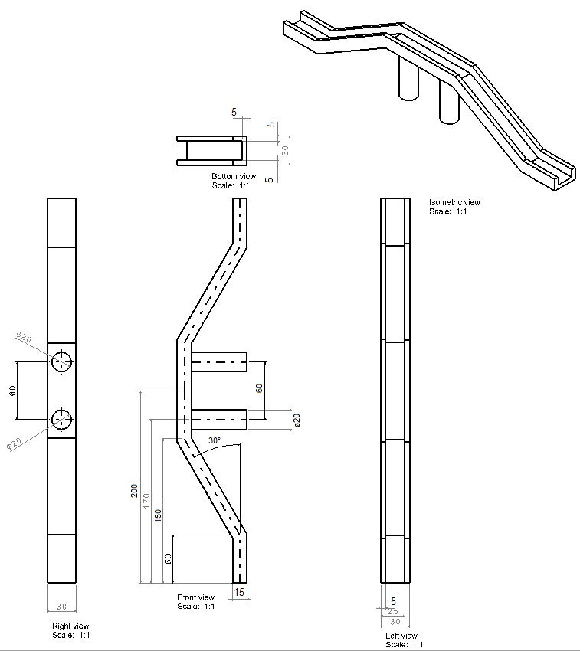
3
CADD(Computer Aided Design and Drafting) H.W. #6
H.W. #6

Slide 7
3
CADD(Computer Aided Design and Drafting) H.W. #6
H.W. #6

Slide 8
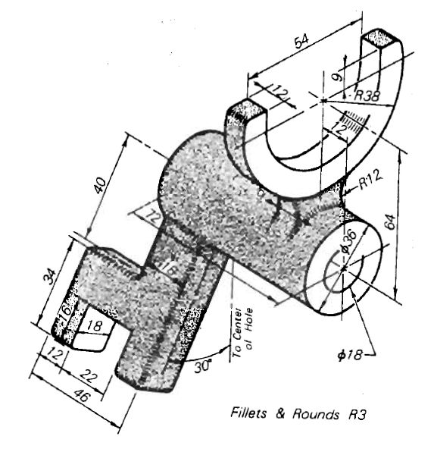
4
CADD(Computer Aided Design and Drafting) H.W. #6
H.W. #6

Slide 9
4
CADD(Computer Aided Design and Drafting) H.W. #6
H.W. #6

Slide 10
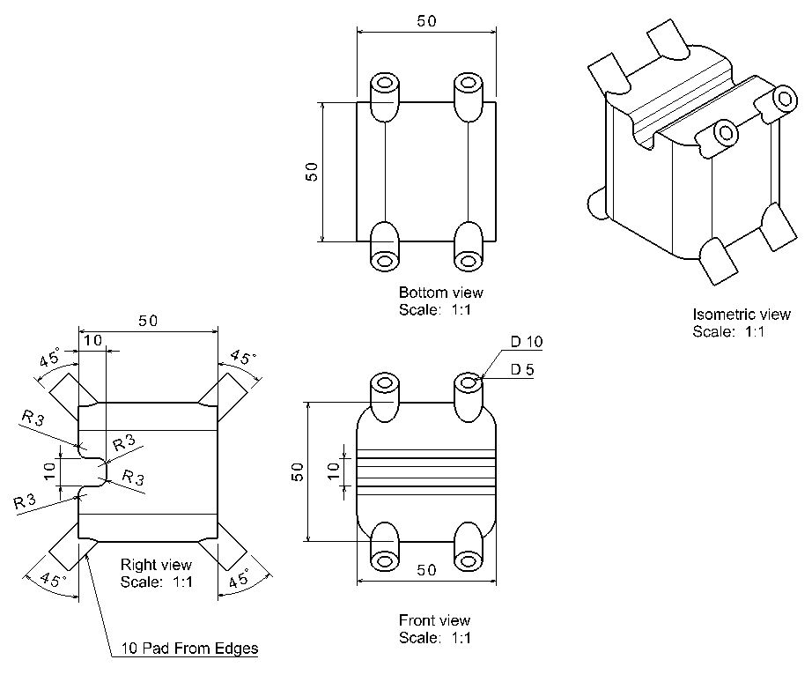
5
CADD(Computer Aided Design and Drafting) H.W. #6
H.W. #6

Slide 11
5
CADD(Computer Aided Design and Drafting) H.W. #6
H.W. #6

Slide 12
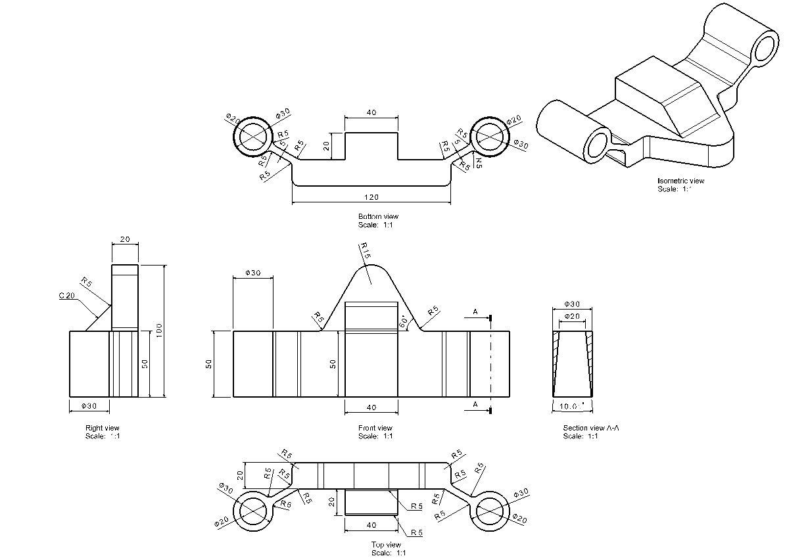
6
CADD(Computer Aided Design and Drafting) H.W. #6
H.W. #6

Slide 13
6
CADD(Computer Aided Design and Drafting) H.W. #6
H.W. #6

