Slide 1
2021 학년도 기계공학과 CADD (MEE1002) CADD(Computer Aided Design and Drafting) H.W. #6
학번 :
이름 :
2021년 10월 14일

Slide 2
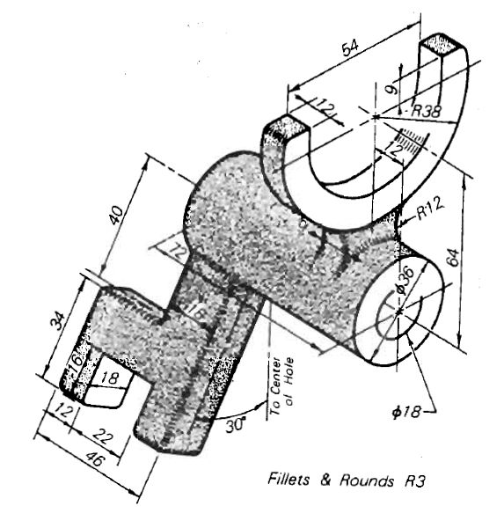
1
CADD(Computer Aided Design and Drafting) H.W. #6
H.W. #6

Slide 3
1
CADD(Computer Aided Design and Drafting) H.W. #6
H.W. #6

Slide 4
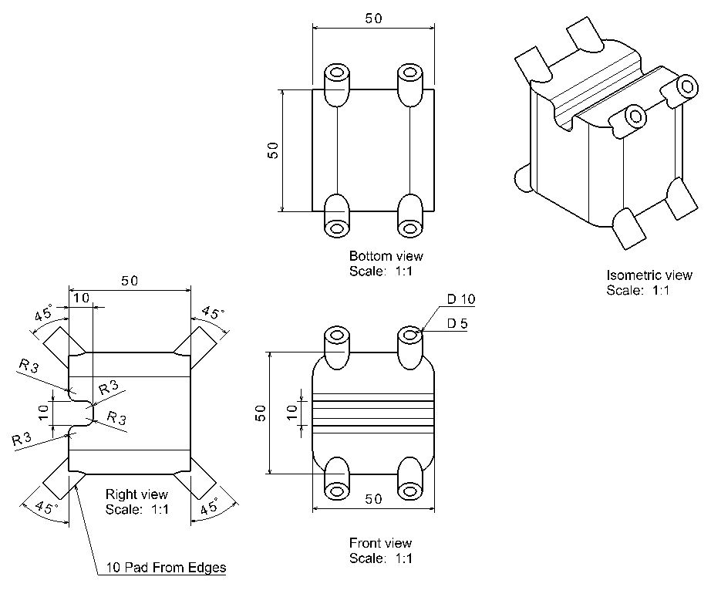
1
CADD(Computer Aided Design and Drafting) H.W. #6
H.W. #6

Slide 5
1
CADD(Computer Aided Design and Drafting) H.W. #6
H.W. #6

Slide 6
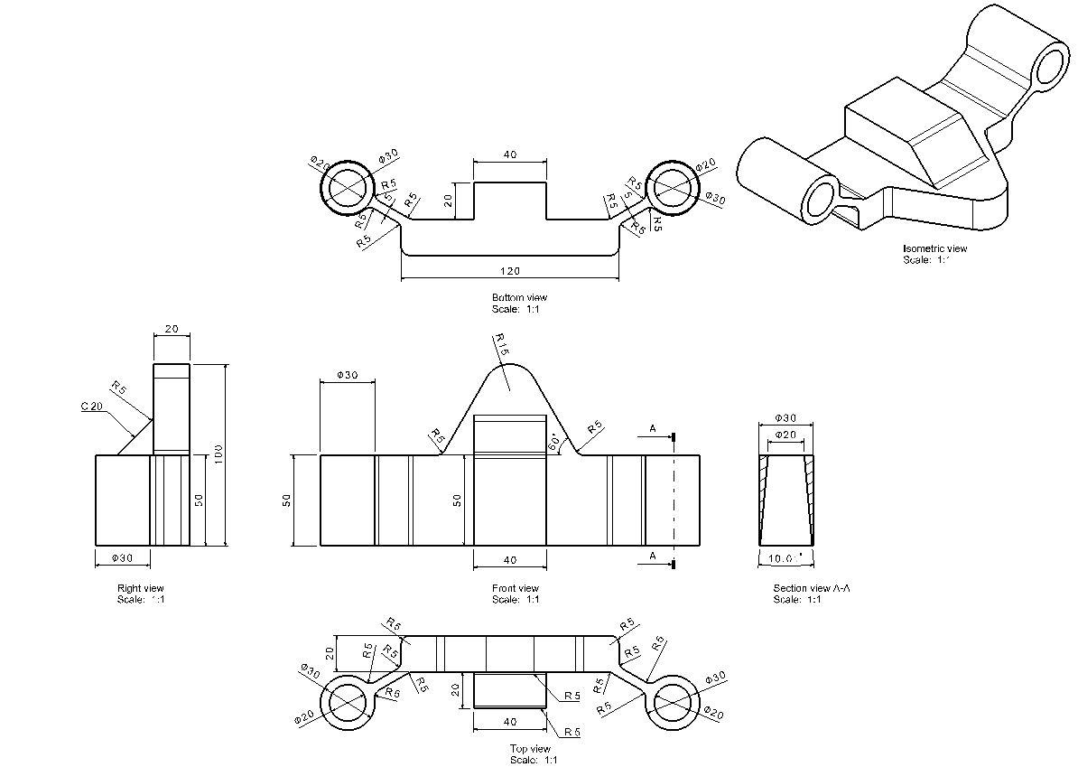
1
CADD(Computer Aided Design and Drafting) H.W. #6
H.W. #6

Slide 7
1
CADD(Computer Aided Design and Drafting) H.W. #6
H.W. #6

Slide 8
1
CADD(Computer Aided Design and Drafting) H.W. #6
H.W. #6

Slide 9
1
CADD(Computer Aided Design and Drafting) H.W. #6
H.W. #6

