Slide 1
2021 학년도 기계공학과 CADD (MEE1002) CADD(Computer Aided Design and Drafting) H.W. #2
학번 :
이름 :
2021년 9월 27일

Slide 2
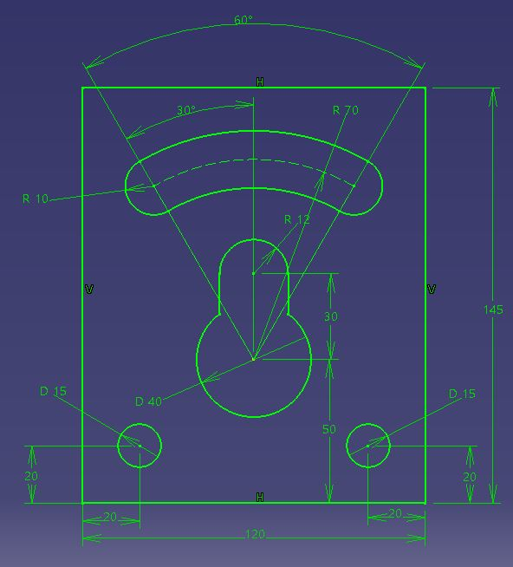
1
CADD(Computer Aided Design and Drafting) H.W. #2
H.W. #2

Slide 3
1
CADD(Computer Aided Design and Drafting) H.W. #2
H.W. #2

Slide 4
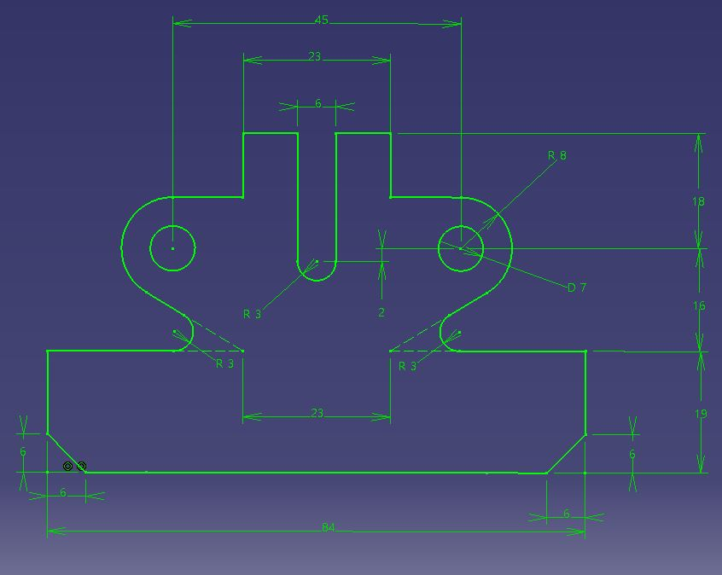
1
CADD(Computer Aided Design and Drafting) H.W. #2
H.W. #2

Slide 5
1
CADD(Computer Aided Design and Drafting) H.W. #2
H.W. #2

Slide 6
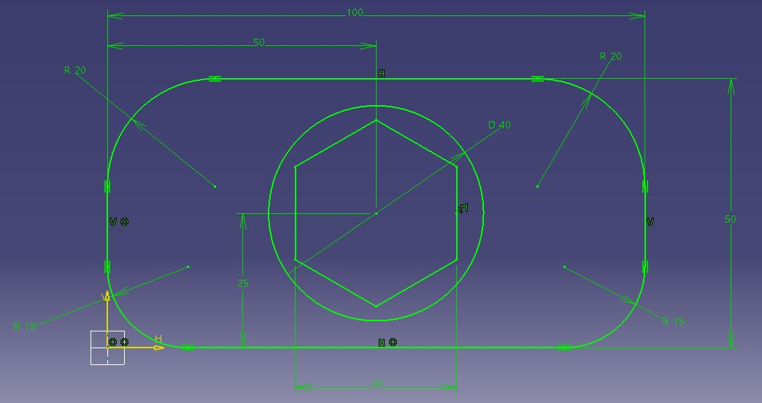
1
CADD(Computer Aided Design and Drafting) H.W. #2
H.W. #2
30

Slide 7
1
CADD(Computer Aided Design and Drafting) H.W. #2
H.W. #2

Slide 8
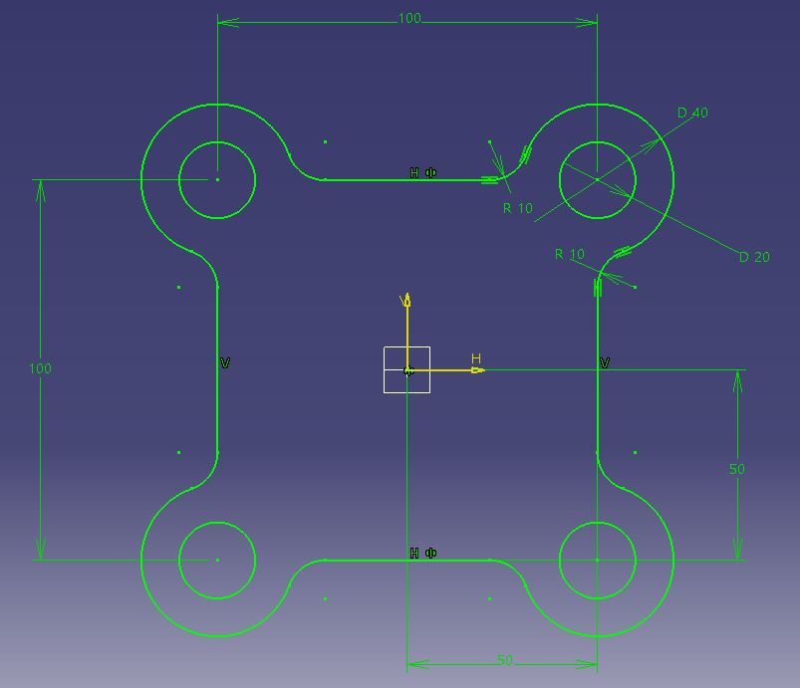
1
CADD(Computer Aided Design and Drafting) H.W. #2
H.W. #2

Slide 9
1
CADD(Computer Aided Design and Drafting) H.W. #2
H.W. #2

Slide 10
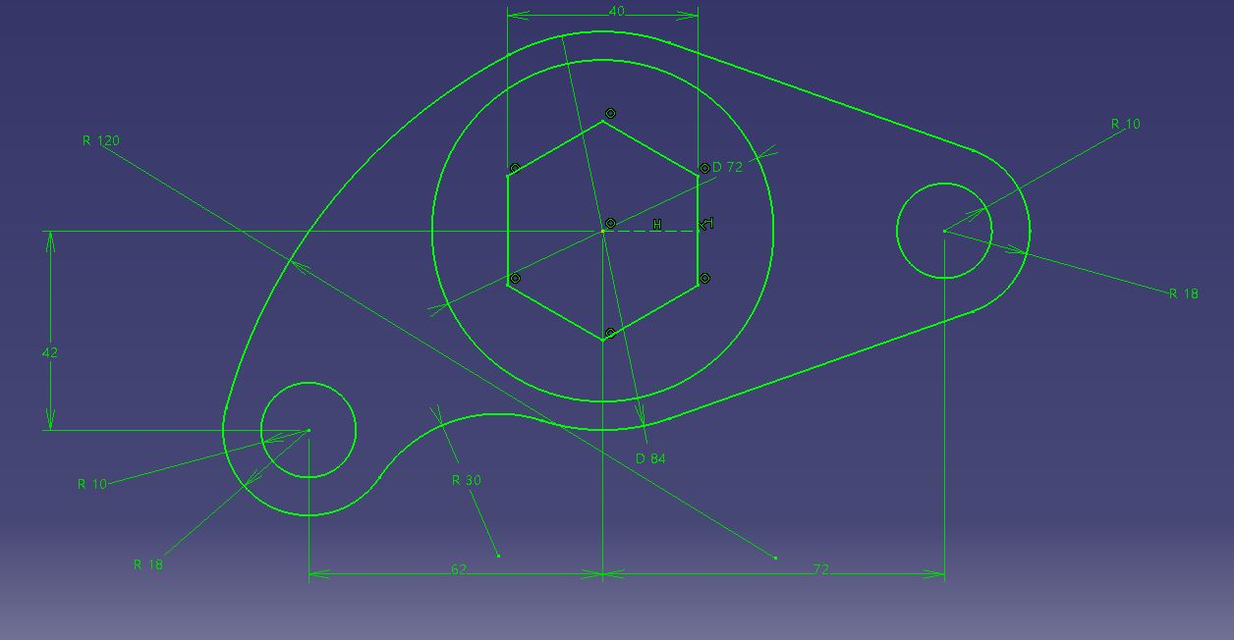
1
CADD(Computer Aided Design and Drafting) H.W. #2
H.W. #2

Slide 11
1
CADD(Computer Aided Design and Drafting) H.W. #2
H.W. #2

