Slide 1
2021 학년도 기계공학과 CADD (MEE1002) CADD(Computer Aided Design and Drafting) H.W. #1
학번 :
이름 :
2021년 9월 9일

Slide 2
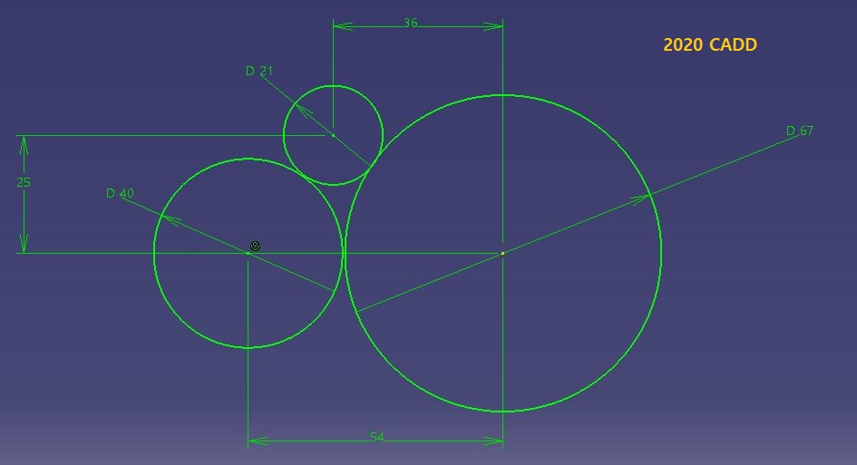
1
CADD(Computer Aided Design and Drafting) H.W. #1
H.W. #1

Slide 3
1
CADD(Computer Aided Design and Drafting) H.W. #1
H.W. #1

Slide 4
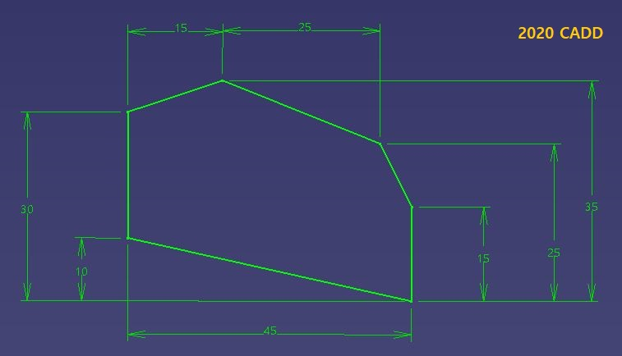
1
CADD(Computer Aided Design and Drafting) H.W. #1
H.W. #1

Slide 5
1
CADD(Computer Aided Design and Drafting) H.W. #1
H.W. #1

Slide 6
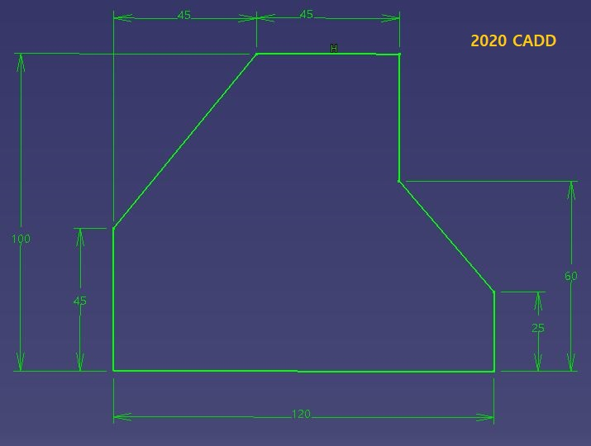
1
CADD(Computer Aided Design and Drafting) H.W. #1
H.W. #1

Slide 7
1
CADD(Computer Aided Design and Drafting) H.W. #1
H.W. #1

Slide 8
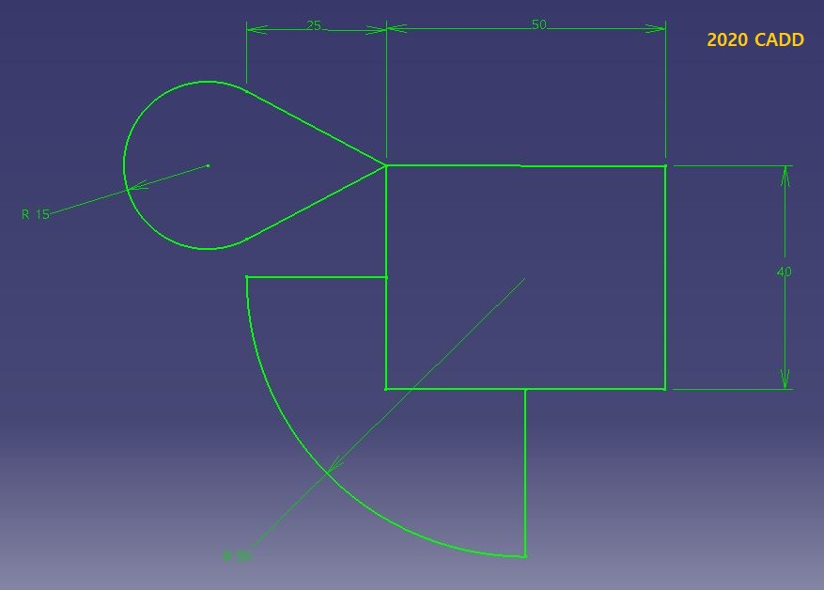
1
CADD(Computer Aided Design and Drafting) H.W. #1
H.W. #1
R 50

Slide 9
1
CADD(Computer Aided Design and Drafting) H.W. #1
H.W. #1

Slide 10
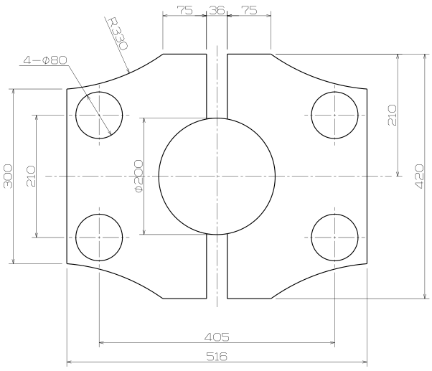
1
CADD(Computer Aided Design and Drafting) H.W. #1
H.W. #1

Slide 11
1
CADD(Computer Aided Design and Drafting) H.W. #1
H.W. #1

